Slide 1
Fundamentals of Algorithms and Data Structures Lecture 4 – Nonlinear Data Structures: Trees
Prof. André Gustavo Hochuli
gustavo.hochuli@pucpr.br
aghochuli@ppgia.pucpr.br
Notes:
Prof. André Hochuli

Slide 2
Outline
Nonlinear Data Structures
Tree Concepts
Binary Trees
Balanced Binary Trees (AVL – Adelson-Velsky and Landis)
Algorithms and Data Structures – Prof. André Hochuli
Lecture 04
Notes:
Prof. André Hochuli

Slide 3
Trees
Notes:
Prof. André Hochuli

Slide 4
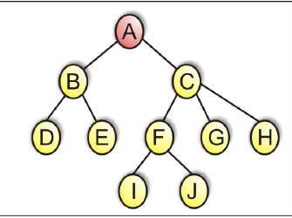
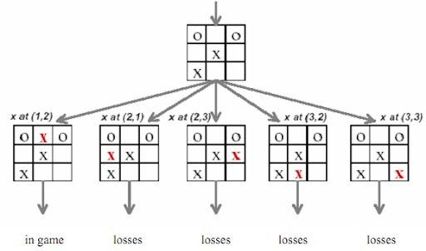
Trees
Nonlinear Data Structures
Hierarchical Representation
Applications
Syntax Checkers(Grammars, Compilers)
Databases
Routers
Process Schedulers
Artificial Intelligence (AI)
Algorithms and Data Structures – Prof. André Hochuli
Lecture 04
Notes:
Prof. André Hochuli

Slide 5
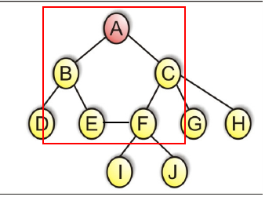
Tree Data Structures – Core Concepts
Trees Do Not Contain Cycles
Degree
Number of subtrees (i.e., number of children of a node)
Nodes: A = 2, C = 3, D = 0
Tree Degree: 3 (maximum node degree in the tree)
Level
Distance from a node to the root
Nodes: D = 2, I = 3
Tree Level (Height): 3
Algorithms and Data Structures – Prof. André Hochuli
Lecture 04
Notes:
Prof. André Hochuli

Slide 6
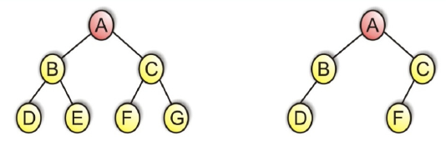
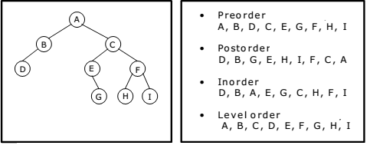
Binary Tree Structures
Binary Trees Have a Maximum Degree of 2
Tree Traversal (Visitation Strategy)
Preorder: root → left → right
Postorder: left → right → root
Inorder: left → root → right
Level-order*: level by level (N = 0 → N = 1 → …)
(*) Non-recursive method
(*) Requires a queue (tree traversal using a queue)
Algorithms and Data Structures – Prof. André Hochuli
Lecture 04
Notes:
Prof. André Hochuli

Slide 7
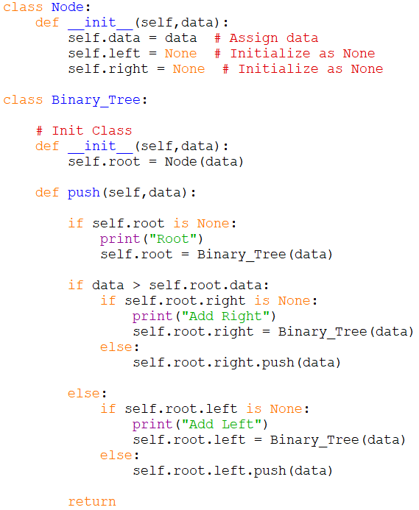
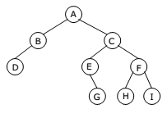
Binary Tree - Implementation
Algorithms and Data Structures – Prof. André Hochuli
Lecture 04
Notes:
Prof. André Hochuli

Slide 8
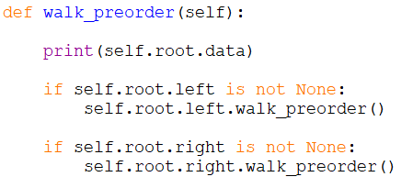
Trees - Transversal
Algorithms and Data Structures – Prof. André Hochuli
Lecture 04
Notes:
Prof. André Hochuli

Slide 9
Trees - Exercise
Implement the following tree traversals:
Post-Order Transversal
In-Order Transversal
Algorithms and Data Structures – Prof. André Hochuli
Lecture 04
Notes:
Prof. André Hochuli

Slide 10
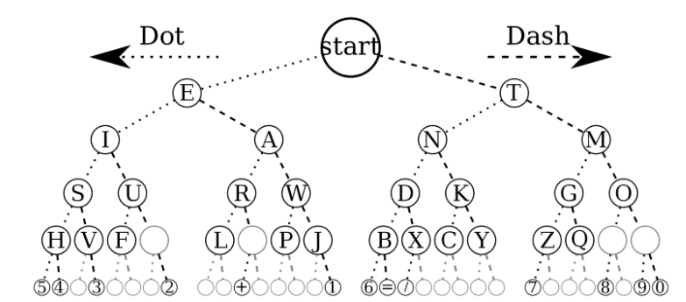
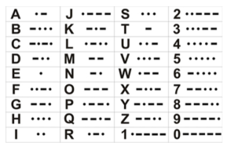
Trees – Exercise
Implementing a Morse Code Translator
Algorithms and Data Structures – Prof. André Hochuli
Lecture 04
Notes:
Prof. André Hochuli

Slide 11
AVL Trees (Adelson-Velsky and Landis Trees)
Notes:
Prof. André Hochuli

Slide 12
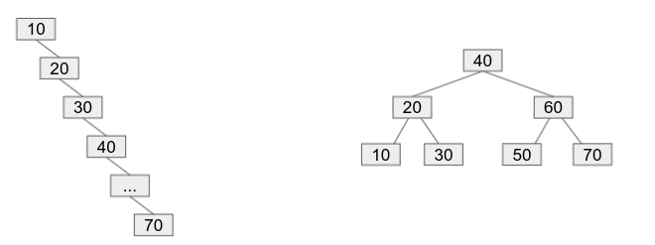
AVL Balanced Binary Trees
Adelson Velsy e Landis (AVL)
Insert the following keys sequentially into a Binary Search Tree (BST):
10,20,30,40,50,60,70
Causes Tree Imbalance
Algorithms and Data Structures – Prof. André Hochuli
Lecture 04
Notes:
Prof. André Hochuli

Slide 13
AVL Balanced Binary Trees
Adelson Velsy e Landis (AVL)
Insert the following keys sequentially into a Binary Search Tree (BST):
10,20,30,40,50,60,70
AVL Balanced Binary Tree
Unbalanced Tree
Algorithms and Data Structures – Prof. André Hochuli
Lecture 04
Notes:
Prof. André Hochuli

Slide 14
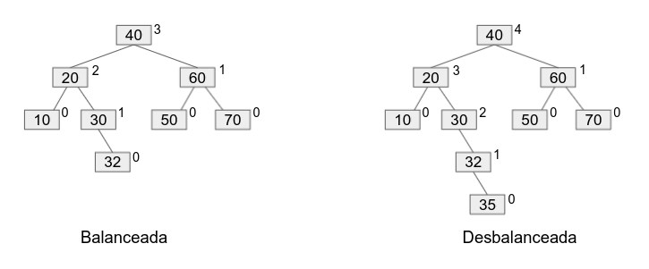
AVL Balanced Binary Trees
Balanced Tree: for every node, the height difference between the left and right subtrees is at most ±1.
That is, the Balance Factor is defined as:
BF(n) = hₗ − hᵣ → |BF(n)| ≤ 1 ⇒ node is balanced
BF(n) = 0 → hₗ = hᵣ
BF(n) > 0 → hₗ > hᵣ
BF(n) < 0 → hₗ < hᵣ
Notation:
( hₗ ): height of the left subtree
( hᵣ ): height of the right subtree
Balanced Tree
Unbalanced Tree
Algorithms and Data Structures – Prof. André Hochuli
Lecture 04
Notes:
Prof. André Hochuli

Slide 15
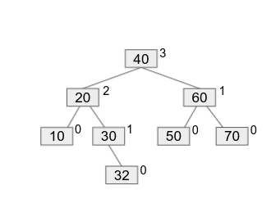
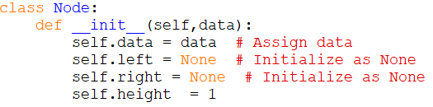
AVL Balanced Binary Trees
Algorithms and Data Structures – Prof. André Hochuli
Lecture 04
Notes:
Prof. André Hochuli

Slide 16
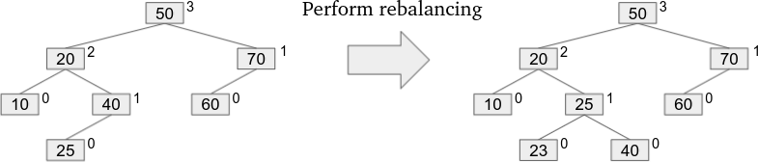
AVL Balanced Binary Trees
Insertion Step:
Insert key 23
Perform rebalancing if |BF| > 1
How to Determine Rotations (AVL)?
RR → Right Rotation
LL → Left Rotation
LR → Left + Right
RL → Right + Left
Algorithms and Data Structures – Prof. André Hochuli
Lecture 04
Notes:
Prof. André Hochuli

Slide 17
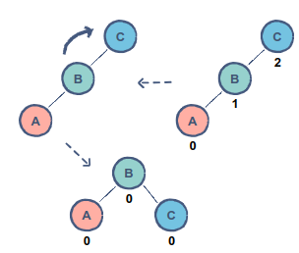
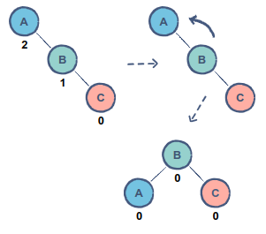
AVL Balanced Binary Trees
Right Rotation (RR)
BF > 1 and insertion occurs in the left subtree of left child
Left Rotation (LL)
BF < -1 and the inserted value is in the right subtree of right child
Algorithms and Data Structures – Prof. André Hochuli
Lecture 04
Notes:
Prof. André Hochuli

Slide 18
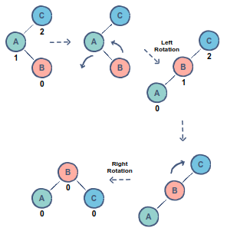
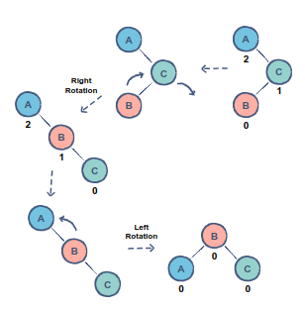
AVL Balanced Binary Trees
Double Rotation LR :
Left (on child) → Right (on node)
BF > 1 e insertion occurs in the right subtree of the left child
Double Rotation RL :
Right (on child) → Left (on node)
BF > -1 e insertion occurs in the right subtree of the left child
Algorithms and Data Structures – Prof. André Hochuli
Lecture 04
Notes:
Prof. André Hochuli

Slide 19
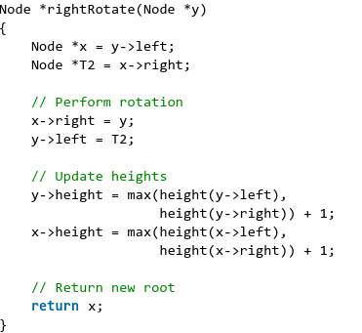
AVL Balanced Binary Trees
Right Rotation (RR)
BF > 1 and insertion occurs in the left subtree of left child
Algorithms and Data Structures – Prof. André Hochuli
Lecture 04
Notes:
Prof. André Hochuli

Slide 20
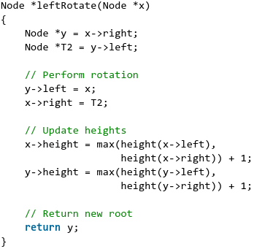
AVL Balanced Binary Trees
Left Rotation (LL)
BF < -1 and the inserted value is in the right subtree of right child
Algorithms and Data Structures – Prof. André Hochuli
Lecture 04
Notes:
Prof. André Hochuli

Slide 21

AVL Balanced Binary Trees
LR (Double Rotation):
Left (on child) → Right (on node)
BF > 1 and insertion occurs in the right subtree of the left child
Algorithms and Data Structures – Prof. André Hochuli
Lecture 04
Notes:
Prof. André Hochuli

Slide 22

AVL Balanced Binary Trees
RL (Double Rotation):
Right (on child) → Left (on node)
BF < −1 and insertion occurs in the left subtree of the right child
Algorithms and Data Structures – Prof. André Hochuli
Lecture 04
Notes:
Prof. André Hochuli

Slide 23
AVL Balanced Binary Trees
Exercise (Manual Practice)
Insert the following sequences into both an AVL tree and a non-balanced binary search tree:
10, 3, 2, 5, 7, 6
A, B, C, …, J
Then, for both trees, compute:
the inorder traversal
the number of comparisons/search steps needed to find 7 and H
the asymptotic time complexity (Big-O)
Explain why the complexities differ between AVL and unbalanced trees.
AVL Simulators:
https://cmps-people.ok.ubc.ca/ylucet/DS/AVLtree.html
https://visualgo.net/en
Algorithms and Data Structures – Prof. André Hochuli
Lecture 04
Notes:
Prof. André Hochuli

Slide 24
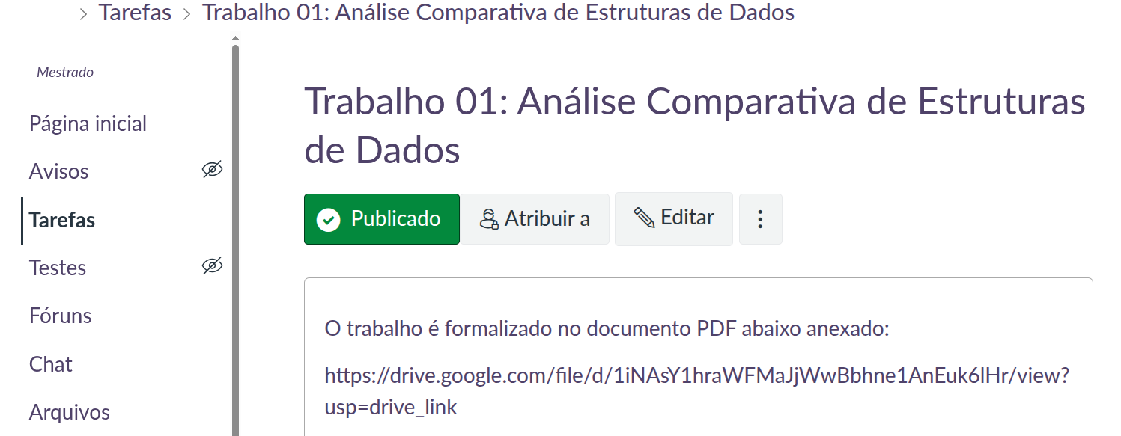
Assignment
Trabalho 01: Análise Comparativa de Estruturas de Dados
!!! Groups must be created via Canvas !!!
!!! Students must be assigned to a group by the deadline to receive a grade !!!
Algorithms and Data Structures – Prof. André Hochuli
Lecture 04
Notes:
Prof. André Hochuli

